Slide 1
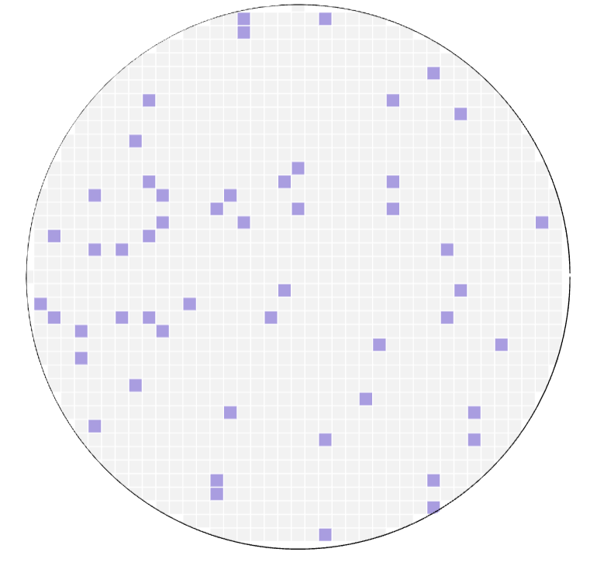
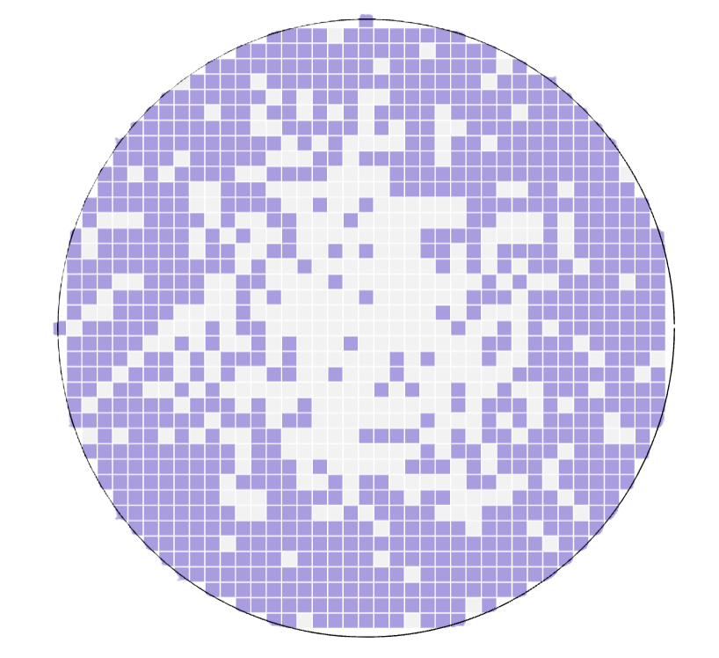
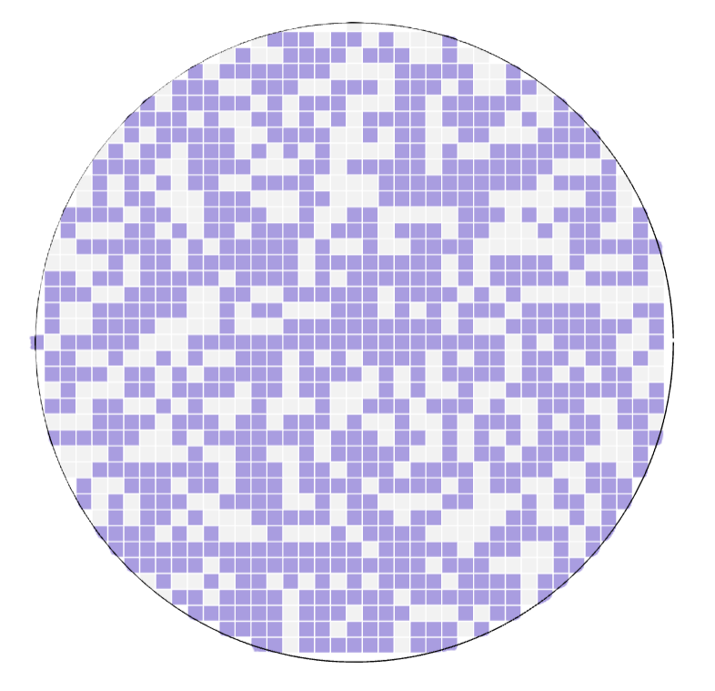
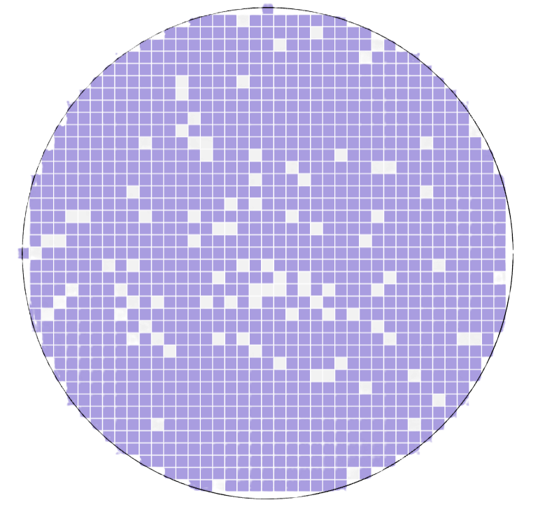
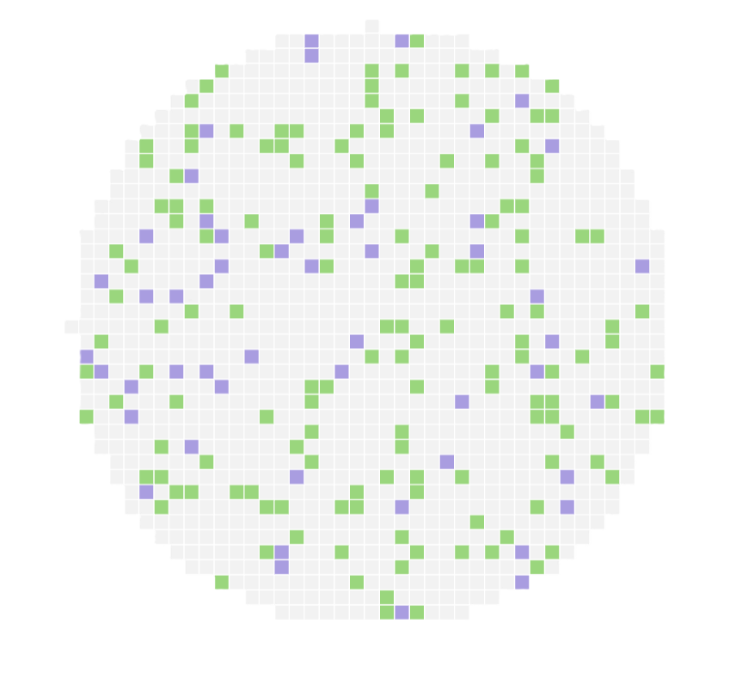
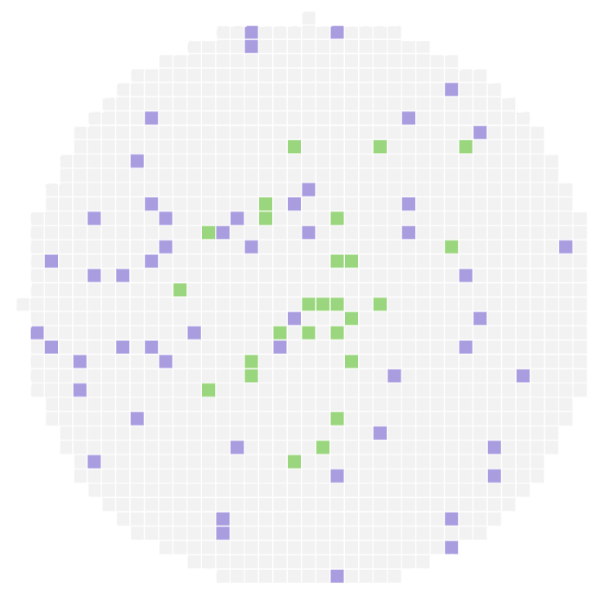
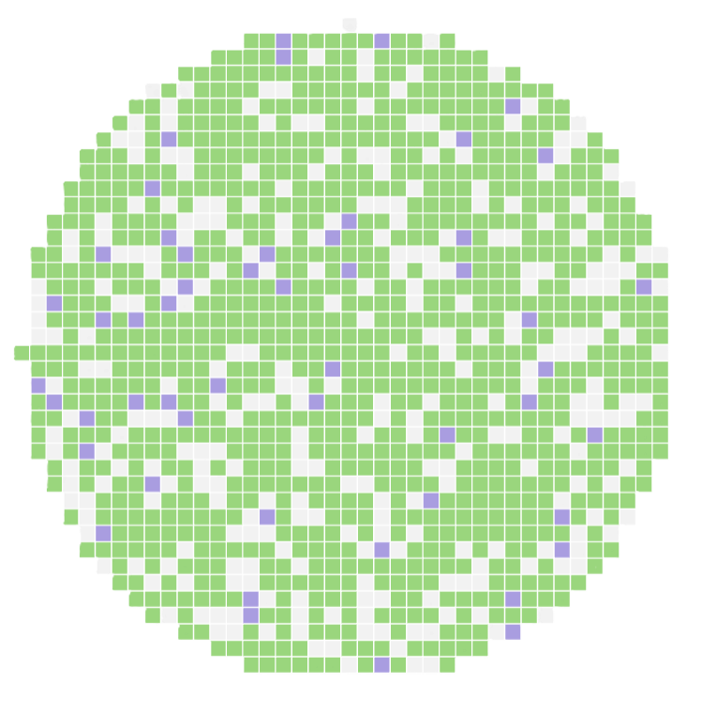
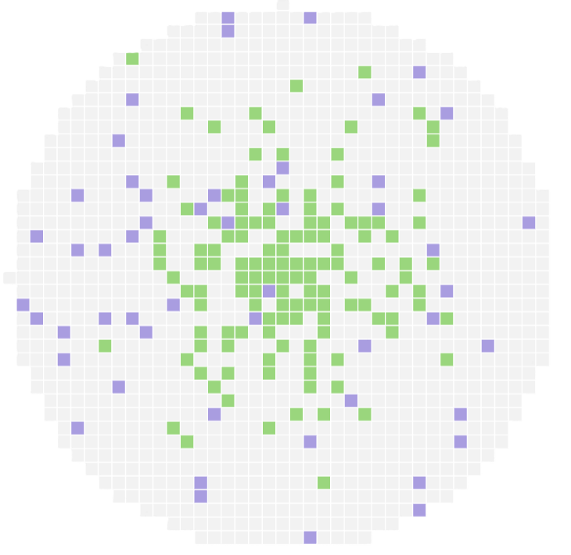
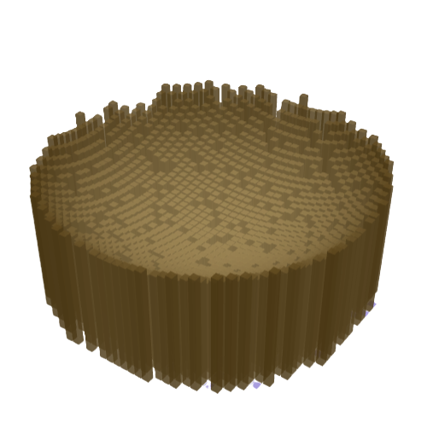
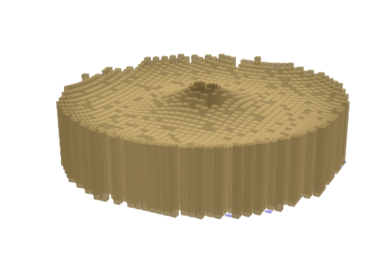
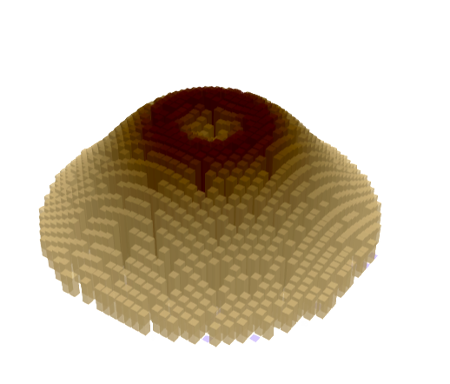
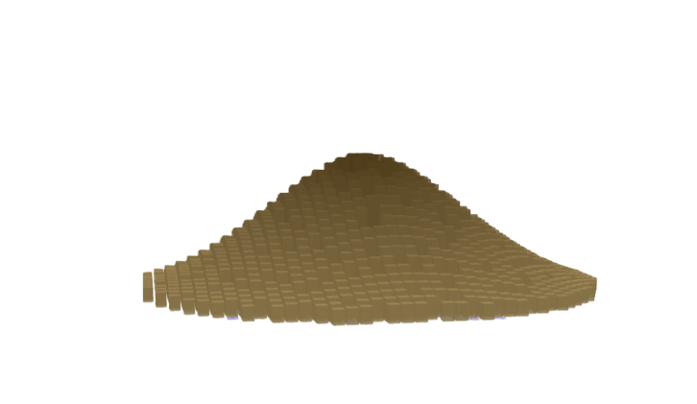
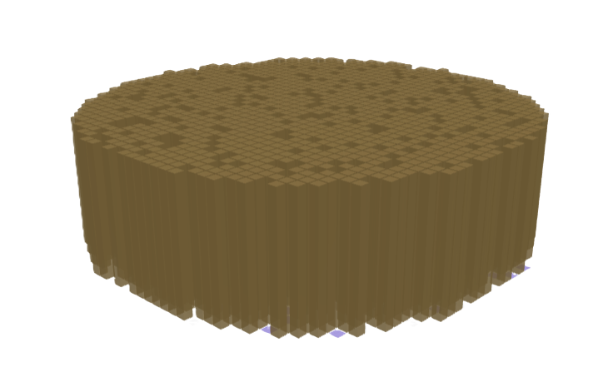







(a) Horizontal Constraints Types
Structural Zeros (cannot be constructed)
Constructable Area
$$ψ\left(r\right)=logistic(α+β∙r)$$
$α$ small, $β$small
$α$ small, $β$large
$α$ large, $β$small
$α$ large, $β$large
Uniformly Open
Edge constrained
Uniformly constrained
Locked
(b) Horizontal Construction Types
Buildings
Structural Zeros
Constructable Area
$π (r)=logistic(κ−δ∙r)$
κ small δ small
κ small δ large
κ large δ small
κ large δ large
Uniformly sparse
Thinly built
Uniformly dense
Core-dense
(c) Vertical Profile Types
$$H(r)=A∙exp(Br+Cr^{2})$$
C>0, B>0
“Bowl” City
C>0, B<0
“Crown” City
C=0, B=0
“Pancake” City
C<0, B>0
“Volcanic Cone” City
C<0, B<0
“Pyramid” City
H
H
H
H
H
0
r
0
r
0
r
0
r
0
r

